Slide 1
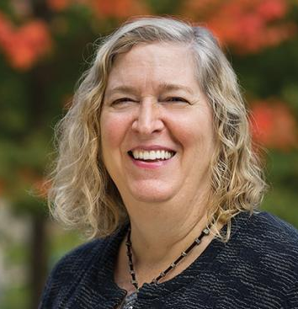
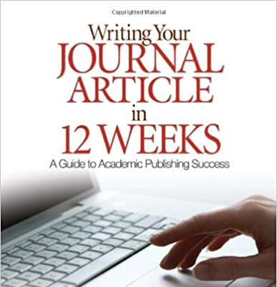
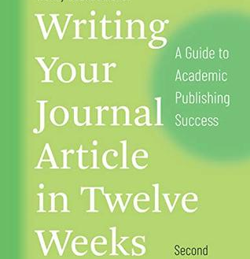
خطة النشر في 12 أسبوع
د.سيف السويدي

Slide 2
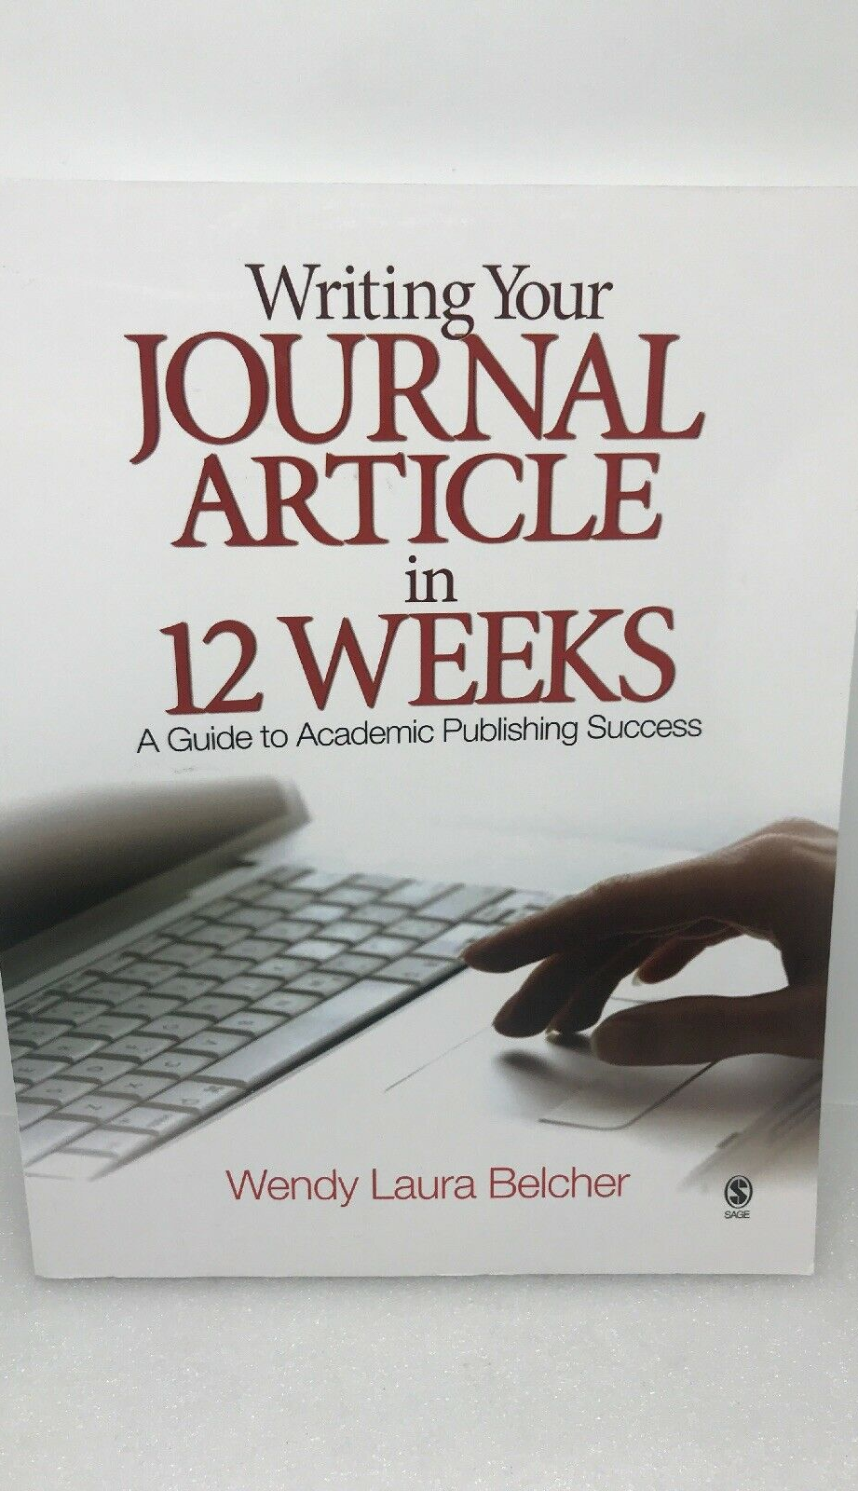
Writing Your Journal Article in 12 Weeks

Slide 3
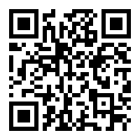
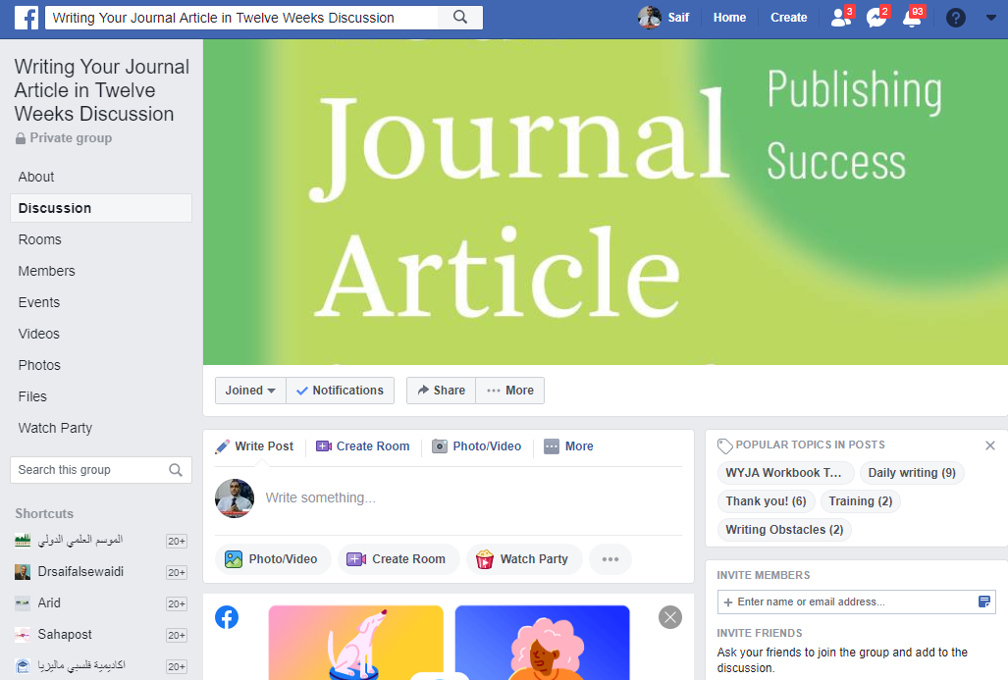
https://www.facebook.com/groups/15857235914

Slide 4
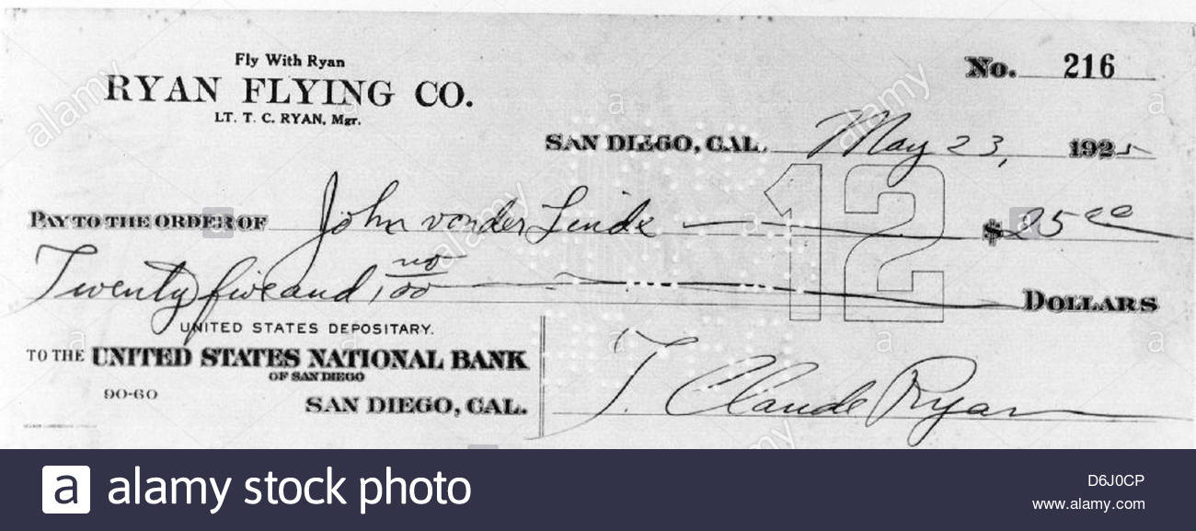
العقاب او المكافأة من اجل التحفيز

Slide 5
Partner

Slide 6
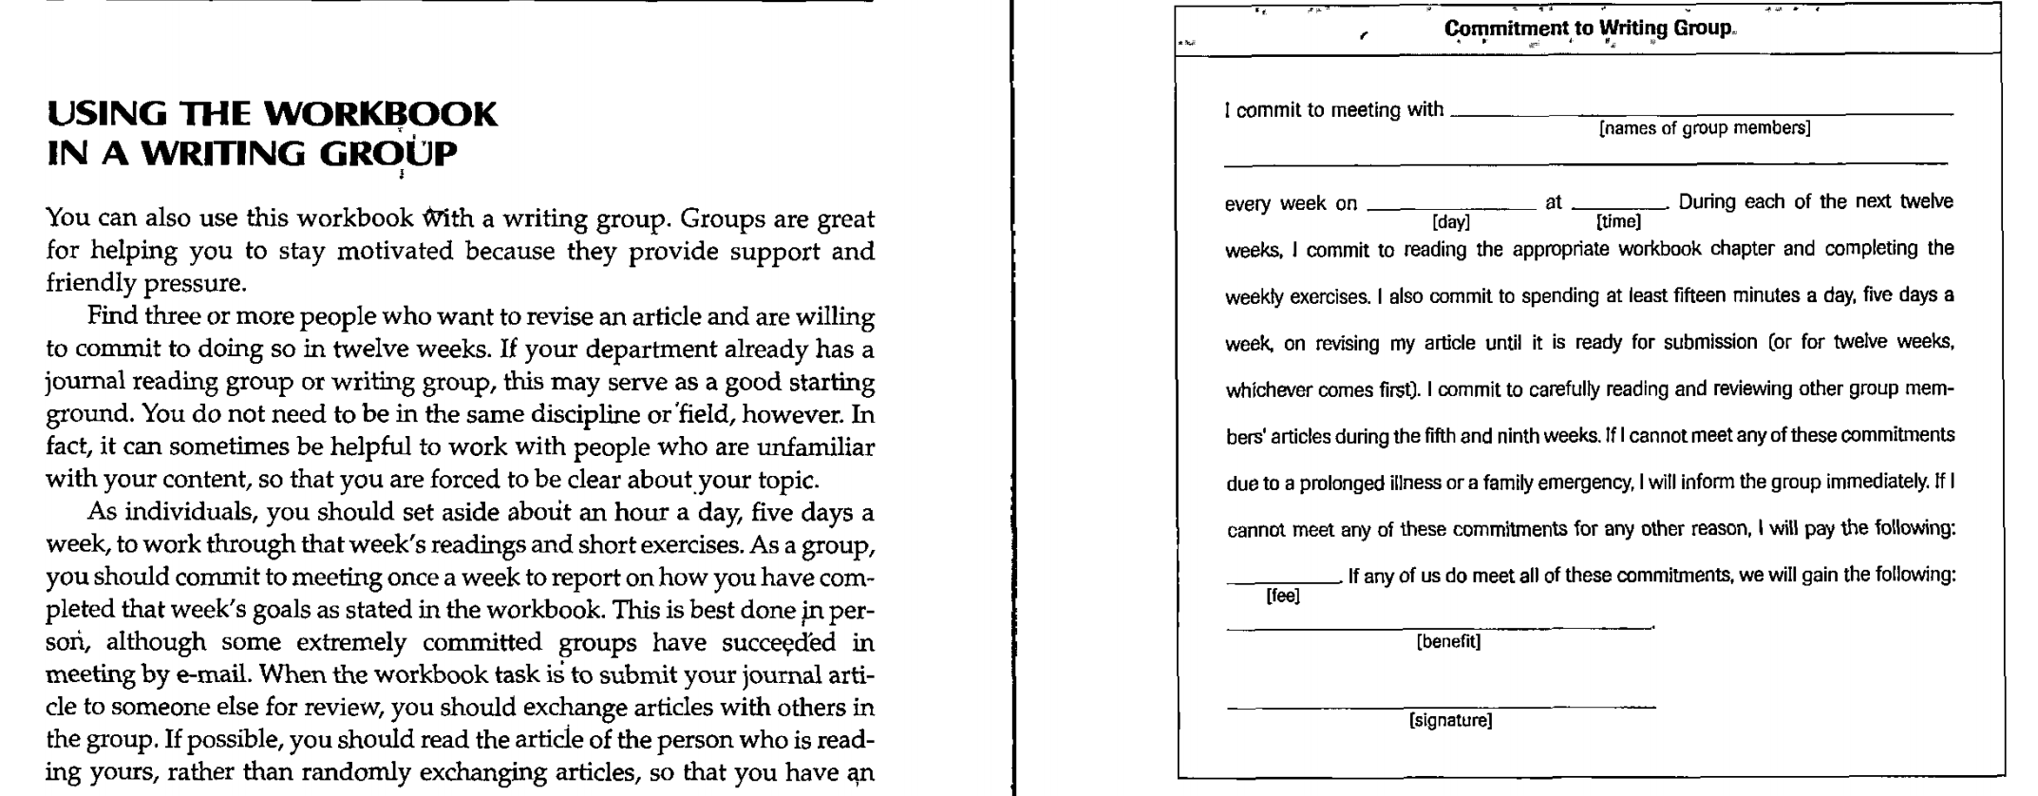

Slide 7
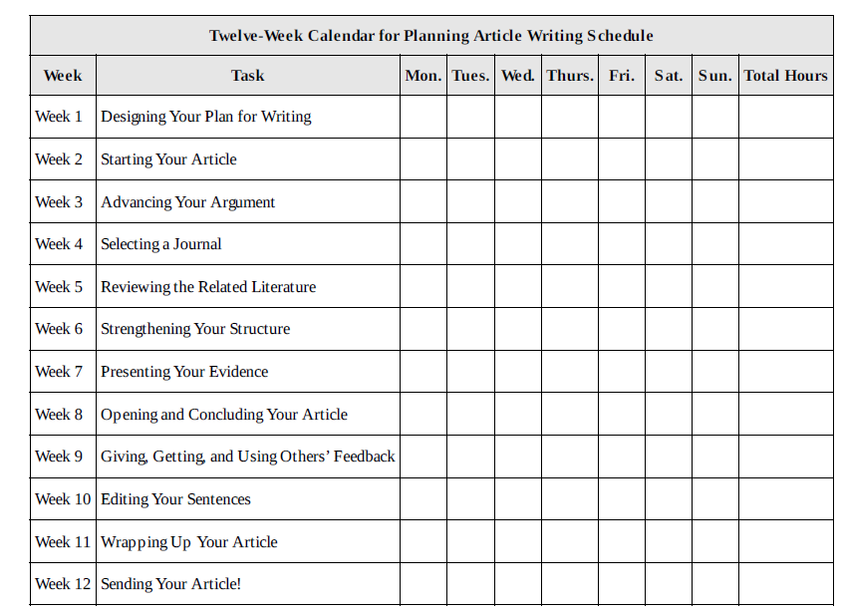

Slide 8
Week 1 : Designing your plan for writing

Slide 9
Days Tasks
Instruction: Understanding feelings about writing.
Keys to positive writing experiences.
Designing a plan for submitting your article in twelve weeks.
Exercises: Selecting a paper for revision.
Choosing your writing site.
Designing your writing schedule.
Anticipating and overturning writing obstacles.

Slide 10
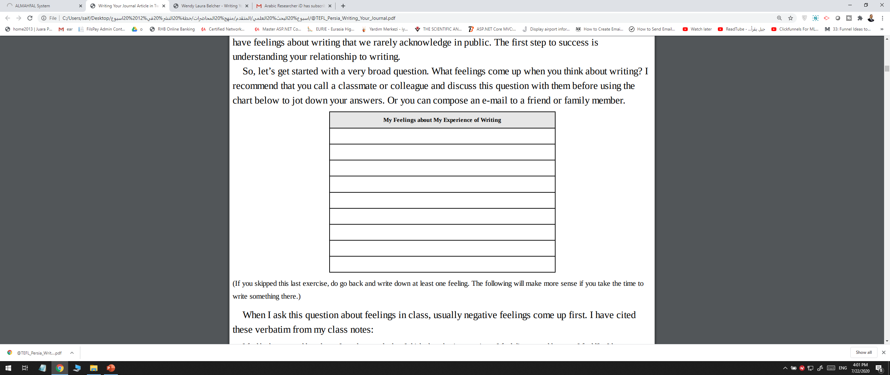
ما المشاعر التي تظهر عندما تفكر في الكتابة؟

Slide 11
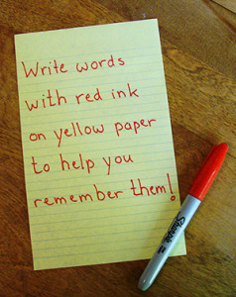

Slide 12
Develop a habit of writing
The point of writing regularly is to develop a habit of writing, and part of that is having a habitual writing spot. Use the chart below to indicate your writing sites.

Slide 13
Anticipating Writing Obstacles
Obstacle No. 1: I really am too busy!
Obstacle No. 2: Teaching preparation takes up all my extra time.
Obstacle No. 3: I will write just as soon as (fill in the blank).
Obstacle No. 4: I’m too depressed to write.
Obstacle No. 5: I’m going to make writing my number one goal in life.
Obstacle No. 6: I couldn’t get to my writing site.
Obstacle No. 7: I have to read just one more book.
Obstacle No. 8: I just can’t get started.
Obstacle No. 9: I’m afraid of writing because my idea is very controversial or emotional.

Slide 14
Anticipating Writing Obstacles
Obstacle No. 10: I’m afraid of writing because publication is so permanent.
Obstacle No. 11: I’m not in the right mood to write.
Obstacle No. 12: My childcare responsibilities are preventing me from writing.
Obstacle No. 13: I really can’t move forward on this writing project.
Obstacle No. 14: I can’t write because my idea sucks.
Obstacle No 15: My thesis advisor is more of an obstacle than an aid.
Obstacle No. 16: I can’t sit still.

Slide 15
Anticipating Writing Obstacles
Obstacle No. 17: I feel guilty about not writing.
Obstacle No 18: I write so slowly that I never seem to get much done.
Obstacle No. 19: If I have a long, productive writing day, somehow it is harder to get started the next day, rather than easier.
Obstacle No. 20: I know my writing habits are bad, but that’s just who I am and I can’t/don’t want to change.
Obstacle No. 21: I am eager to write but I don’t have the material or scholarly resources.
Obstacle No. 22: I have to make progress on several writing projects at the same time, and I am in a panic.

Slide 16
Anticipating Writing Obstacles
Obstacle No. 23: I would love to ask someone to read and comment on my work but everyone seems so busy and I don’t want to bother them.
Obstacle No. 24: I’m beginning to wonder if being a professor is really the career for me, so what’s the point of writing? I probably won’t get a job anyway.
Obstacle No. 25: I’m not smart enough to do this kind of work.
Obstacle No. 26: I get distracted by web surfing, e-mailing, and text messaging.
Obstacle No. 27: It is so difficult to write in English!
Obstacle No. 28: I need big blocks of time to write, and my schedule doesn’t allow such blocks.

Slide 17
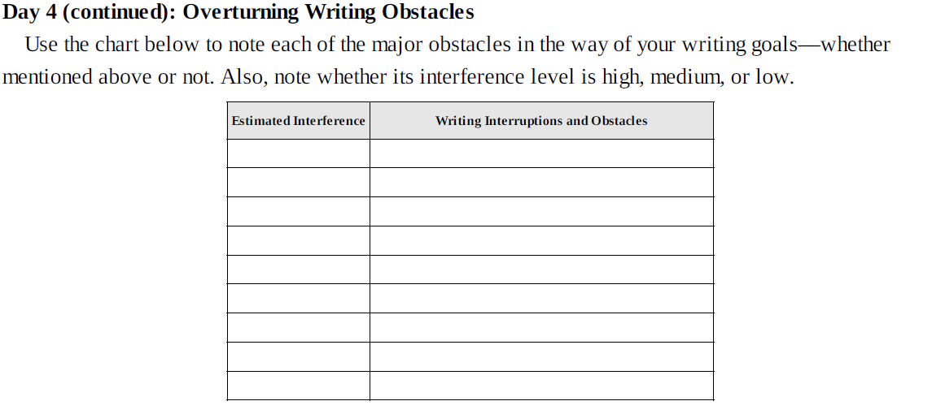

Slide 18
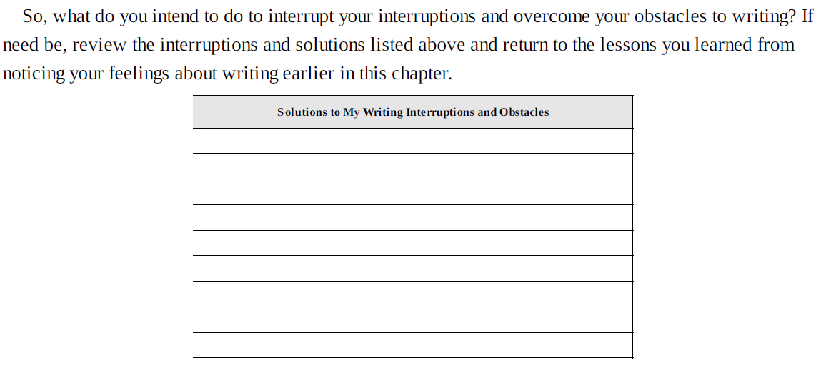

Slide 20
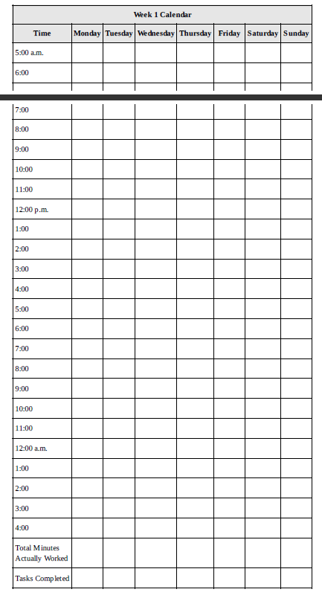

Slide 21
Revision
having a writing partner or advisor.
He or she does not have to be in your discipline; in fact, it may be better if the person is not. It just needs to be someone in the humanities if you are in the humanities, someone in the social sciences if you are in the social sciences
someone who is willing to meet with you for an hour, two or three times over the course of the next twelve weeks.
You do not need big blocks of time to write.
Instead, writing a bit every day is a much more effective writing practice than saving up your writing for the weekend, spring break, the summer, your sabbatical, or retirement. That’s why this workbook breaks down, into manageable chunks, the tasks involved in revising an article for publication. You can do many tasks in an hour or less.
If you manage to get some writing done every day for twelve weeks, you will have done more than submit an article to a journal—you will have developed writing habits that will carry you for a lifetime.
Professors will always need to teach classes and serve on committees. Learning to juggle teaching, service, and writing is a strength that will stand you in excellent stead. If you think of your days as regularly involving all three (e.g., one hour of writing, one hour of reading, one hour of service, one hour of grading and meeting with students, two hours of teaching prep, two hours of class time), you will be well on your way.

Slide 22
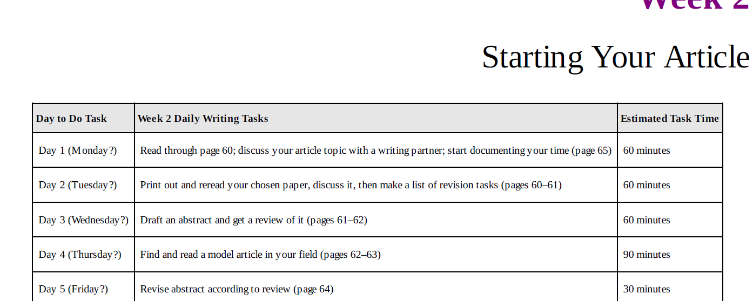
Week 2: Starting Your Article

Slide 23
TYPES OF ACADEMIC ARTICLES
Annotated Bibliography
Book Review
Trade/Professional Article
Notes
Interviews
Translation
Response Article
Review Article
Theoretical Article

Slide 24
TYPES OF ACADEMIC ARTICLES
Social Science Research Article
Quantitative Research Article
Qualitative Research Article
Interpretive Research Article
Humanities Research Article
Natural Science Research Article

Slide 25
ABSTRACTS AS A TOOL FOR SUCCESS
One of the best ways to get started on a revision of your journal article is to write an abstract—
something that describes your article’s topic and argument. Unfortunately, many scholars see writing an abstract as the last step to publication. In the humanities, writers may never have to write one.
But writing an abstract, regardless of whether journals in your field require it or not, is an important step in revising your article, not mere paperwork. More than one authority has noted that “a well-prepared abstract can be the most important paragraph in your article” (APA 1994, 8). Why is writing an abstract so important?

Slide 26
Solving problems
Writing an abstract helps you clarify in your own mind what your article is about, a real aid in drafting and revising. It helps you solve the problems you will have to solve in the article as a whole. Since an abstract is a miniature version of your article—less than 250 words in the humanities and less than 120 in the social sciences—it provides you with the opportunity to distill your ideas and identify the most important.
It also serves you as a diagnostic tool: If you cannot write a brief abstract of your article, then your article may lack focus.

Slide 27
Connecting with editors
Having an abstract provides a way for editors to connect with your work
without reading your entire article, a real aid in finding an appropriate journal, as we will find in Week 4.
With it, editors can encourage potential peer reviewers to review your article. Since getting reviewers can sometimes be troublesome, this is an important effect of a good abstract.

Slide 28
Getting found
If your abstract is published—and abstracts have grown more common even in
humanities journals—you provide a way for scholars to find your work and read it. Keywords and proper
nouns embedded in the abstract provide an important path to your article for researchers who would not
find your work based on your title alone.

Slide 29
Getting read.
Your abstract is essential in convincing scholars to decide to read your article. It communicates the article’s importance and demonstrates whether reading it will add to a researcher’s knowledge. It helps potential readers decide if your methodology is adequate or your approach is fresh.

Slide 30
Getting cited
Many readers will never go on to read your article, so the most-read piece of your work after the title will be your abstract. In fact, more than one person may cite your article based on reading your abstract alone.
endnote listing such works even if the scholar has only had access to your abstract online.

Slide 31
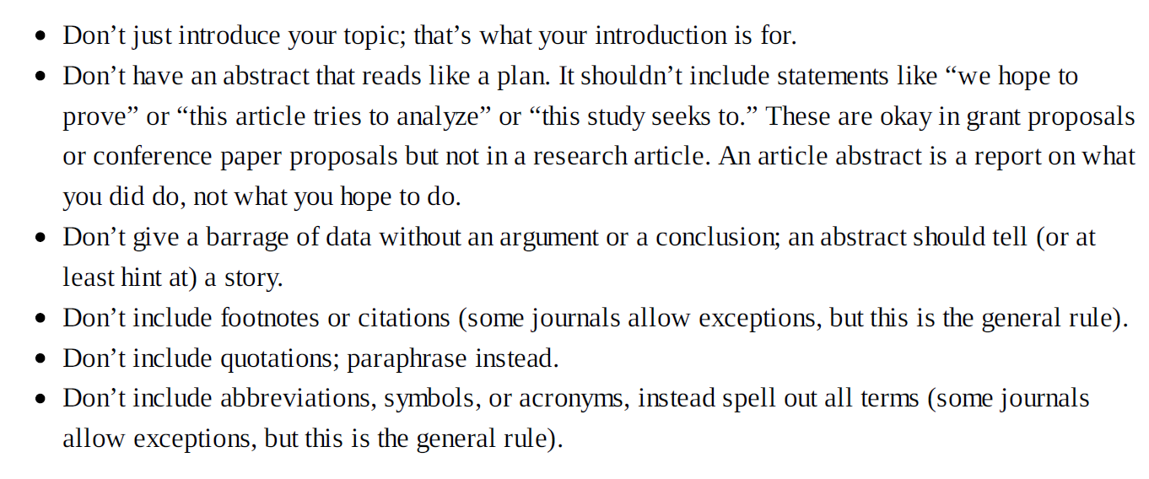
INGREDIENTS OF A GOOD ABSTRACT

Slide 32
Week 2 Revision
If you didn’t get as much writing done last week as you hoped, join the club. Very few scholars ever
feel that they have done enough. Whether you spent long hours working and don’t have much to show for
it, or procrastinated when you had every plan of getting a lot done, avoid feeling guilty and start this new
week afresh. After all, you have twelve weeks to get it right. If you managed to fit in fifteen minutes to an
hour of writing most days, congratulations! You are on your way to making writing a habit.
Either way, take a minute to write in the chart below what you learned this week about making time for
writing. What aided or hindered your writing goals? What were the challenges? What worked? Did you
find any solutions? What could you continue to do or start doing this week to make time for writing? Was
your writing plan for last week realistic or unrealistic? Don’t hesitate to make this social. You can call a
colleague and do this exercise aloud or write an e-mail to a friend.

Slide 33
If you are not happy with what you produced last week, remember that your goal in using this workbook
is productivity, not perfection. It does not matter if what you wrote last week was genius or schlock.
Spending regular time writing is one of the most important things you can do to improve the quality of
your writing. Therefore, a focus on producing will get you to the goal of publication. Continue to aim for
writing at least fifteen minutes a day.
The first week you identified feelings about writing. You learned what makes for a successful academic
writer. You designed a work plan. The second week you studied the various forms of academic articles,
learned the myths about what it takes to get published, and the reality about what makes a research article
publishable. You then hammered out your topic and worked on an abstract. In other words, you
established where you are and how to get where you want to go. This week you are going to identify what
makes an article publishable and learn the main key to a successful revision.

Slide 34
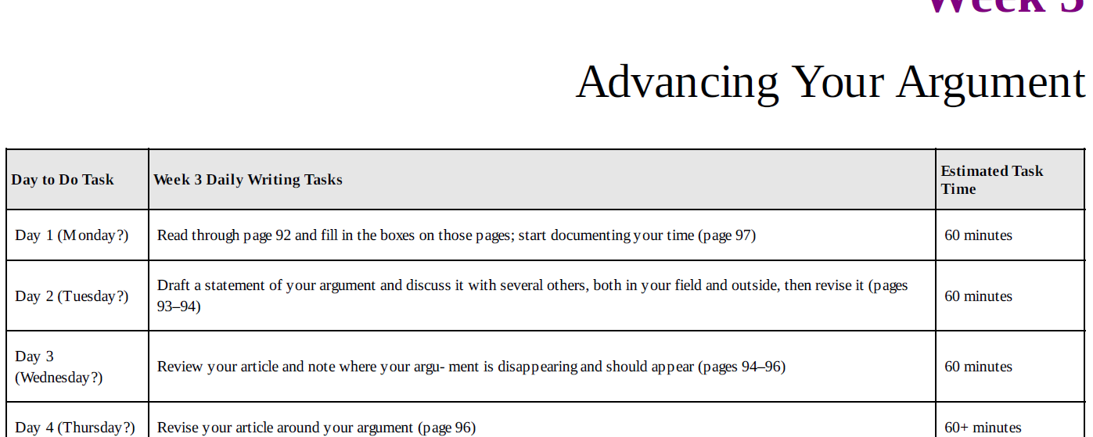
Week 3: Advancing Your Argument

Slide 35
COMMON REASONS WHY JOURNALS REJECT ARTICLES
Too Narrow or Too Broad
Off Topic
Not Scholarly
Too Defensive
Not Sufficiently Original
Poor Structure
Not Significant
Theoretically or Methodologically Issue
Too Many Misspellings and Grammatical Errors
NO ARGUMENT (problem statement) - Editors or reviewers may not mention the lack of an argument as a reason for rejection
الحجة هي خطاب يهدف إلى الإقناع

Slide 36
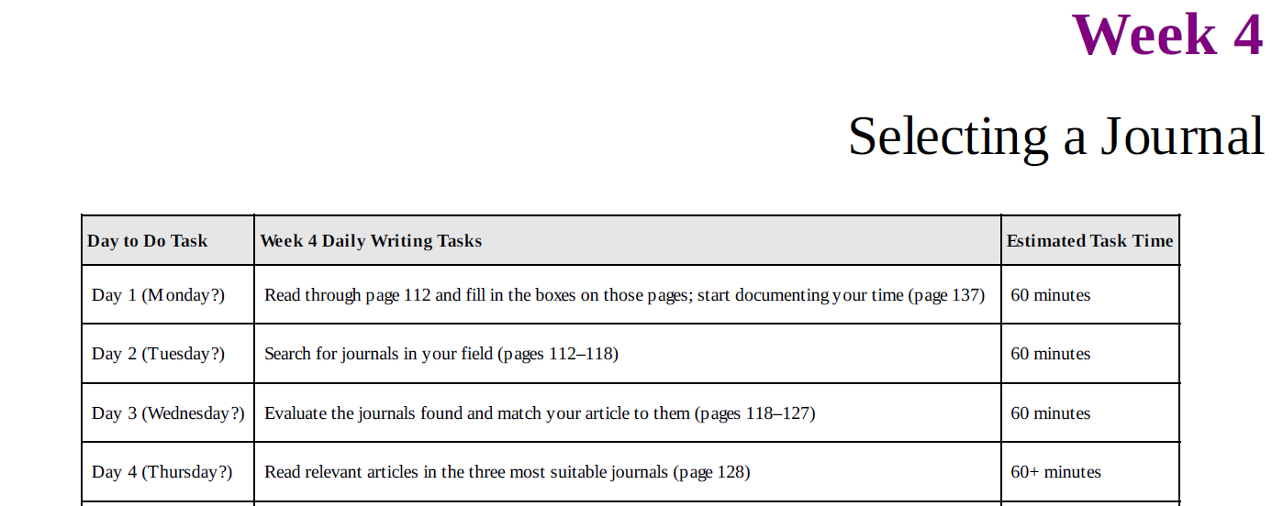
Week 4: Selecting a Journal

Slide 37
THE IMPORTANCE OF PICKING THE RIGHT JOURNAL
I have placed selecting an appropriate journal early in this workbook because you want to make this decision early on and revise your article with a specific journal in mind. Many professors don’t even write an article until they have decided to which journal they will send it.

Slide 38
Journal Selection
One of the most frequent reasons an article is rejected is that it did not meet that particular journal’s requirements.
Even well-written articles will go unpublished if submitted to journals that have recently published similar articles on the same topic, have large backlogs of other articles, or have a theoretical emphasis the article lacks. The rejection letter will rarely say this clearly, but many times there was nothing intrinsically wrong with the article, it simply did not fit the journal’s mandate.
The editor may couch this in any number of way, it was too long or too short, too qualitative or too quantitative, too narrow or too broad, too theoretical or too concrete, and so on and so forth—but all these comments really mean the same thing: We don’t publish articles like this.

Slide 39
Journal Selection
you cannot submit your article to more than one journal at a time.
Since you must wait until you get a decision from the first journal before you can submit it to another journal, and since the review process can take three to twelve months, picking the wrong journal can significantly delay publication, perhaps even past the article’s topical relevance.
Always publish in “refereed” academic journals.
Peered review journals : This process is sometimes known as anonymous or blind review (if the author does not know the reviewer but the reviewer knows the author) or double blind review (if neither knows the other)

Slide 40
TYPES OF ACADEMIC JOURNALS
No recommended Publishing Outlets:
Newspapers and magazines
News and information journals
Trade and professional journals
Society and conference proceedings

Slide 41
Questionable Publishing Outlets
Chapters in edited volumes
Non-peer-reviewed academic journals
Graduate student journals
Note journals
Review journals
Local journals
New journals
Electronic journals
Non-U.S. journals

Slide 42
Preferred Publishing Outlets
Regional journals
Newer journals
Interdisciplinary journals
Field journals
Disciplinary journals

Slide 43
Evaluation Process for Potential Journals
Is the journal peer reviewed?
Is the journal in the recommended publishing outlet category?
Does the journal have a solid reputation?
Does the journal have a reputable publisher?
Has the journal been around for a while?
Is the journal carefully produced?
Does the journal come out on time?
Are the authors published in its pages diverse?
Does the journal publish more than five or six articles a year?
Is the journal online or indexed electronically and where?
Does it take a long time to get published once you submit your manuscript?
Is the journal going through a transition?
Who reads the journal?

Slide 44
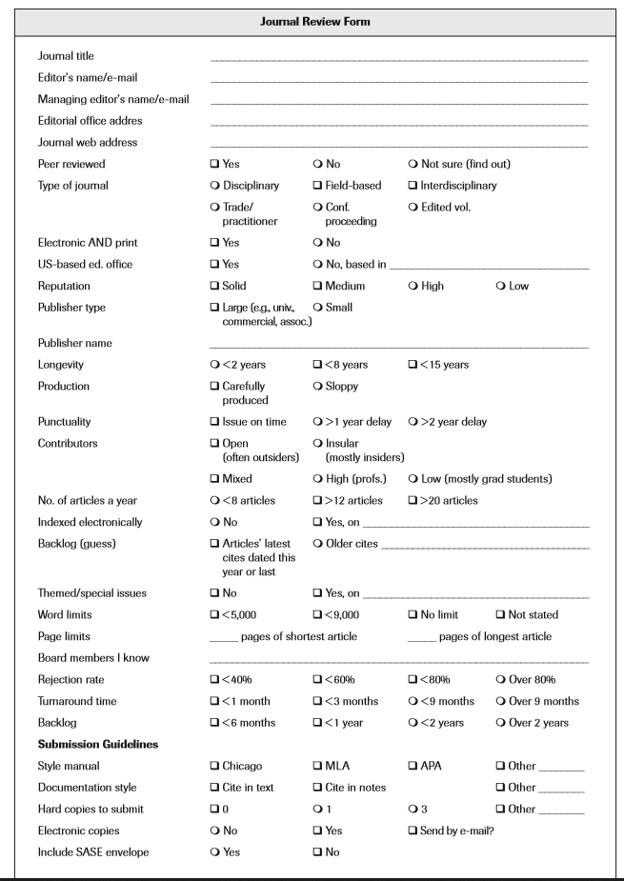

Slide 45
Writing a Query Letter to Editors
Some information about a journal cannot be collected by looking at the journal. Copyright pages, online
submission guidelines, and electronic directories like Ulrich’s will only carry you so far. Some of the
most important information can only be had from the staff of the journal. This is why I recommend that you
e-mail the editors of the two or three journals you are most interested in and ask them some questions.
Some types of questions you should ask of the managing editor, others of the faculty editor. Although it can
seem like hubris to write to one of these figures, I assure you they do not live on Olympian heights. It is
their job to work with authors, and you have the right to ask a few questions before sending your hard
work to them, especially since they get to publish your article for free! I have seen this step of writing to
the editor(s) work to the author’s advantage time and again. The only caveat is that the larger the journal,
the less likely they are to respond helpfully to queries. Journals that receive more than 200 submissions a
year may not respond at all, but I have had students receive helpful replies from very large journals, so I
recommend trying.

Slide 46
So, your task today is to draft two e-mails to the editors of the journals you are most interested in. You
will need a revised abstract to complete this step. After drafting the letters, you can send them whenever
you are ready. Some people wait until their article is final, but I don’t recommend that you wait. Knowing
which journal you intend to submit your article to can shape your writing process. If you do send a query
letter, use the journal log form on page 283 to keep track of what you have sent where.

Slide 47
Review
You have now spent four weeks working on your article. You have worked on designing a writing plan, finalizing your abstract, developing your argument and threading it throughout your article, and identifying appropriate journals for publication. If you have been writing at least fifteen minutes a day, you are doing great!
If you are still not writing regularly or getting around to all the tasks you had hoped to do—don’t feel guilty! Guilt about the past prevents you from action in the present. When you feel bad, it is difficult to get motivated. As a friend once said, you can’t hate yourself into changing. Accept that developing good writing habits often takes longer than four weeks. Then shake off those negative feelings and just focus on today. Today is just as good a day to get started as yesterday, and if you are rereading this tomorrow or in a month or a year, today is still a good day to get started. Since this workbook breaks revising an article down into small steps, you have help in setting reachable goals.
No matter what you did this last week, take a minute to write in the chart below a positive message to yourself about writing. In it, be kind to yourself and be hopeful. If this makes you uneasy, remember what Samuel Johnson wisely said, that intellectuals often believe that an “unwillingness to be pleased” is the proof of intelligence. It is “much easier to find reasons for rejecting than embracing,” he points out (Johnson 1751). So let the embrace be a triumph over the quotidian. In academia, we tend to deify the hostile and the negative. Dare to be positive! You can also phone or e-mail a friend to do this exercise in dialogue.

Slide 48
Week 5: Reviewing the Related Literature

Slide 49
STRATEGIES FOR GETTING READING DONE
Reading Theoretical Literature.
Take theory courses.
Read with an expert.
Read book reviews.
Buy and use reference books.

Slide 50
Reading Related Literature
Set up your bibliographic software
Schedule library reading
Read the newest material first
Don’t wait to write

Slide 51
What’s Your Entry Point?
an argument is something you can coherently respond to by saying, “I agree” or “I disagree.” You enter into the conversation by supporting an argument, debating an argument, or announcing that an argument needs to be made.
Therefore, your entry point is where your argument enters the debate occurring in the previous research on the topic/

Slide 52
Addressing a gap in previous research
Identifying a gap (or more than one) in the literature and setting out to fill it is one of the most common endeavours of journal articles.
It is also a strong claim for significance. Just be sure that your claim is correct if you say that very few scholars have addressed your topic, or no scholar has addressed your topic in quite your way

Slide 53
What Is a Related Literature Review?
For many students, the related literature review is one of the most difficult parts of the article to write.
It is easy to air one’s own ideas; it is not always easy to summarize and evaluate others’ usefully. Related literature reviews vary so much from published article to published article that it can be difficult to determine what the common elements to such reviews are. Sometimes a literature review makes up the entire content of the article, sometimes just a paragraph.

Slide 54
Common Mistakes in Citing the Literature
Don’t cite one source too much.
Don’t cite irrelevant literature.
Don’t overcite definitions.
Don’t misattribute.
Don’t cite the citation.
Don’t cite asides.
Don’t cite the derivative.
Don’t quote too much.
Don’t omit citations.

Slide 55
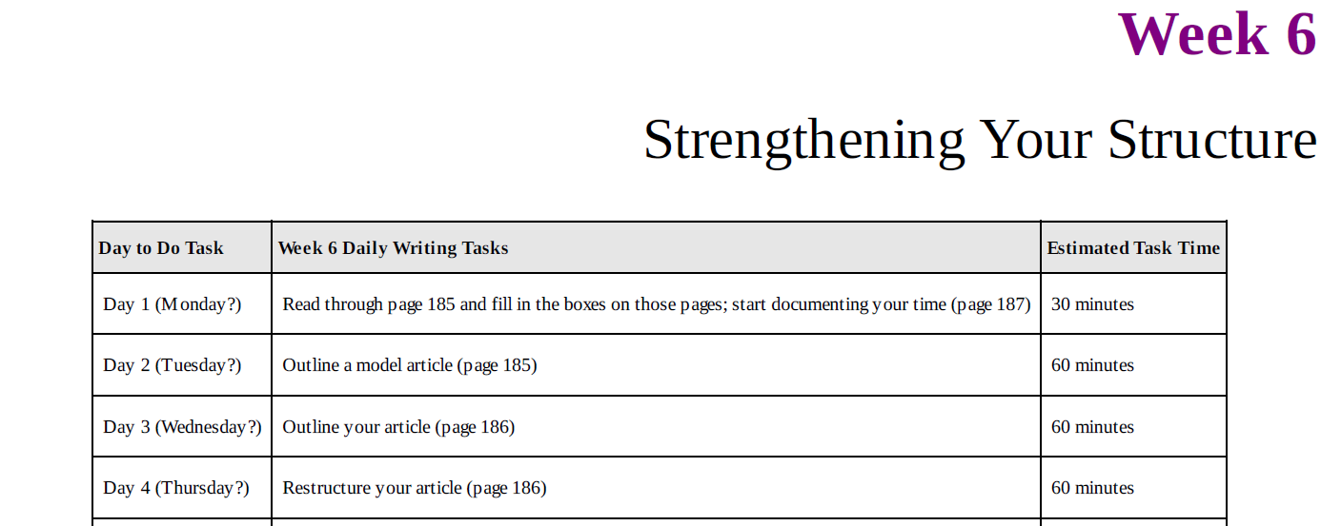
Week 6: Strengthening Your Structure

Slide 56
ON THE IMPORTANCE OF STRUCTURE
Structure is the organization of your argument and the evidence for your argument. When each part of your article leads logically to the next part, you have a coherent structure.
You can think of structure as the skeleton of your article: invisible but essential. Without a skeleton, you have a collapsed biomass. With a skeleton, you have a living, breathing, moving entity.
A strong article structure is important to both you and your readers. Since regular patterns aid readability, readers can more easily grasp the ideas in a structured article than a disorganized one.
The research shows that people read a structured article faster and remember more of it (Meyer 2003).
Regular patterns also aid your thought. Organizing your ideas helps you to understand them better and their connections to each other. Yet, revising your article for structure can be the most difficult revision you do.

Slide 57
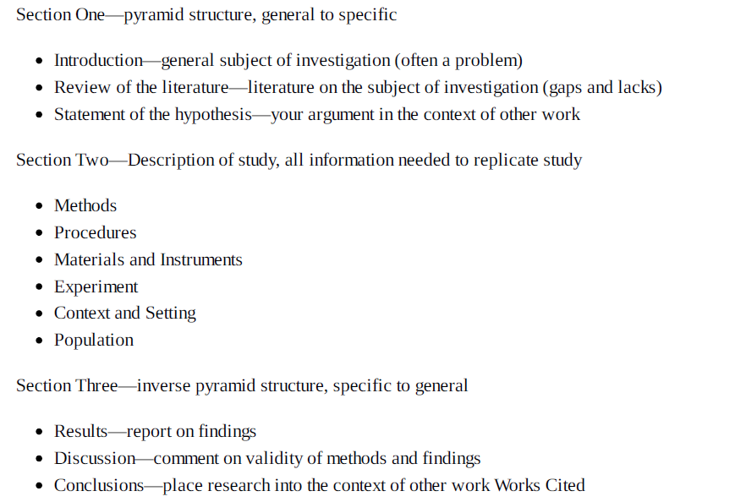

Slide 58
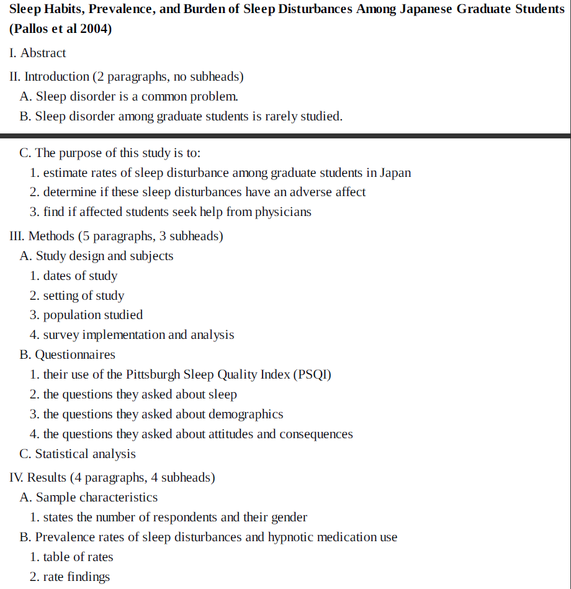

Slide 59
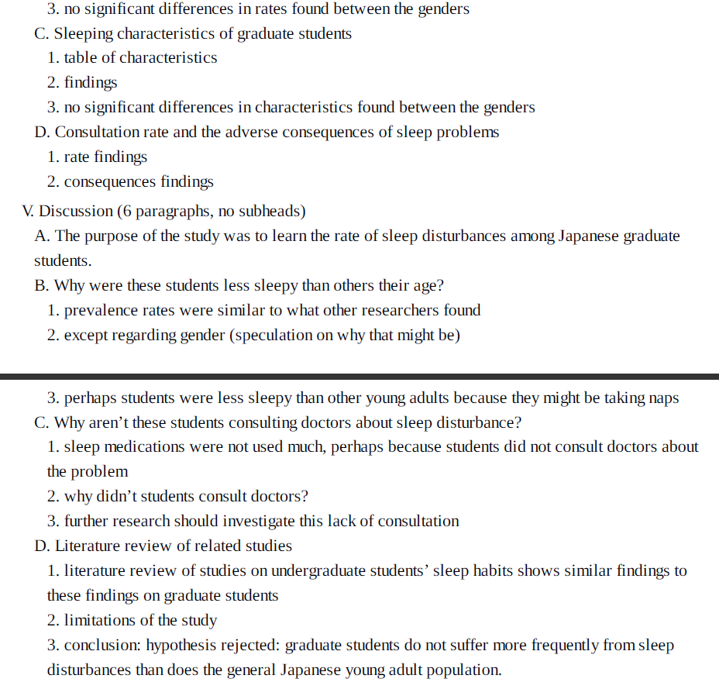

Slide 60
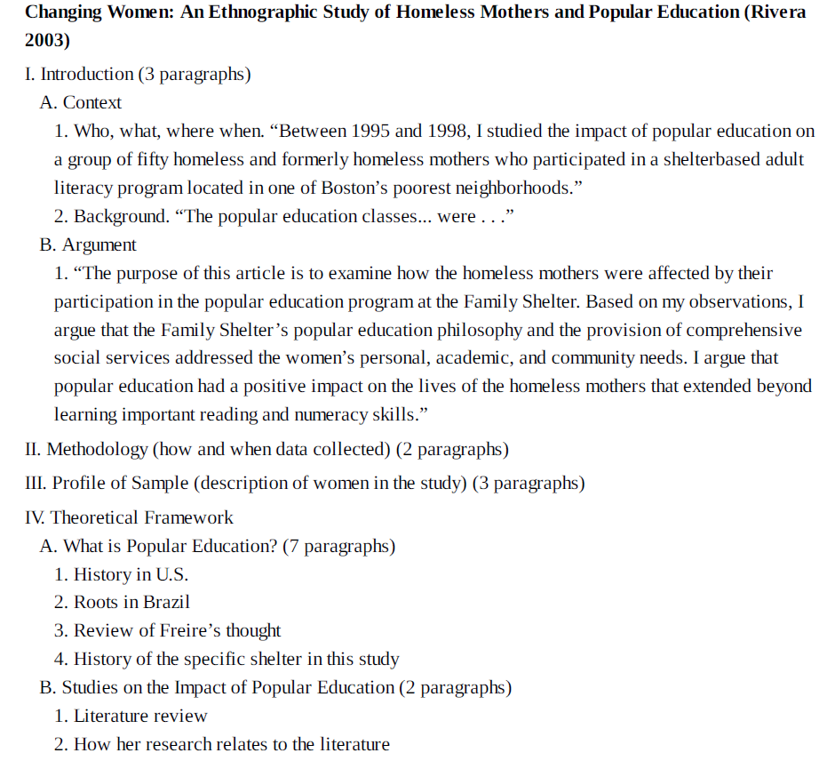
Qualitative Social Science Article Structure

Slide 61
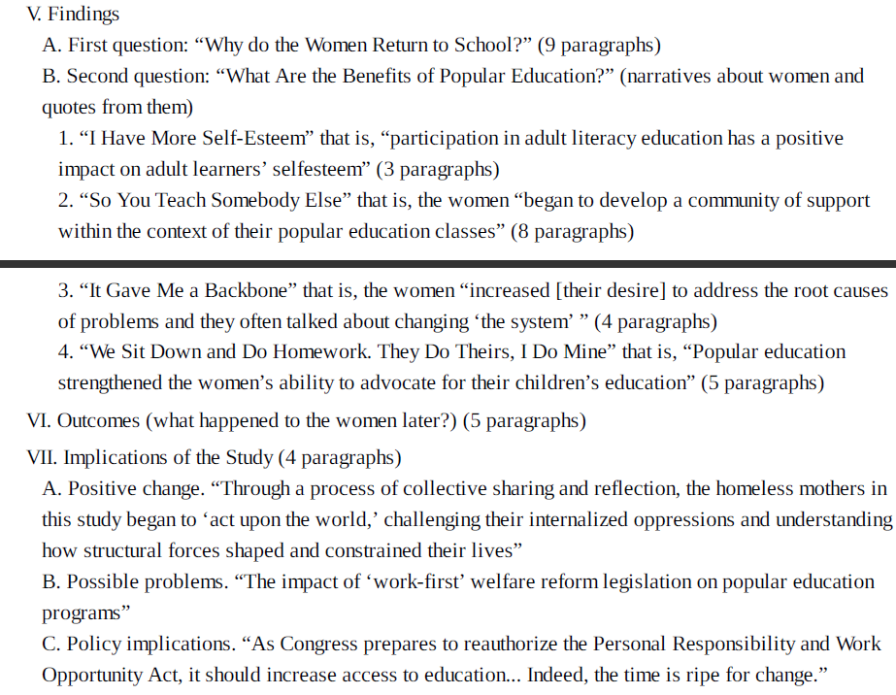

Slide 62
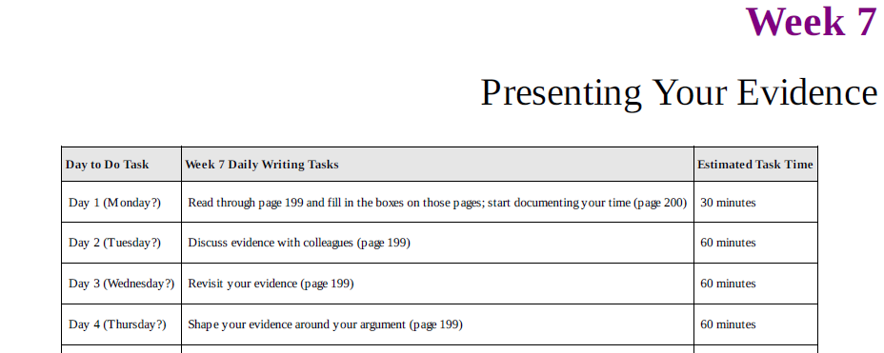
Week 7: Presenting Your Evidence

Slide 63
TYPES OF EVIDENCE
The main body of research articles, where you present your evidence, varies tremendously by discipline, argument, writing style, and personality. Forms of proof in the humanities and social sciences are so different as to be impossible to discuss together. No universal rules exist.
Ask prof. : “What constitutes evidence in our discipline?” You should have some fascinating and fruitful metadiscussions. We benefit from having such discussions more often; turning our critical eye on our own process aids us in making more sophisticated arguments. If you still need more advice than I give here, I recommend some books below that provide detailed instructions on writing up evidence by type and discipline.

Slide 64
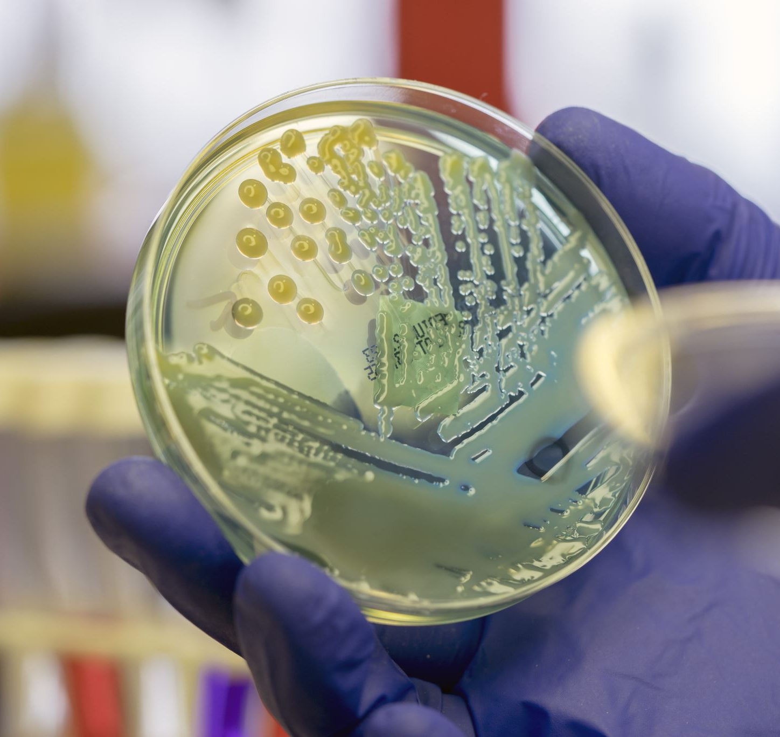
types of evidence do scholars bring to bear in convincing others of their arguments?
Qualitative evidence.
Quantitative evidence.
Historical evidence.
Geographic evidence.
Textual evidence.
Artistic evidence.

Slide 65
Discussion
This is the most difficult section to write and yet the most important. How you write this section can determine your article’s rejection or acceptance. Even if you have great data, your article can get rejected for poor or incorrect interpretation.
Structuring your discussion around your argument will best enable readers to understand the significance of your study for their own research and the field.

Slide 66
Discussion
State whether you confirmed your hypothesis. It is useful to start your discussion by stating your argument or conclusion. That is, what you thought would happen, what did happen, and why you think it happened. Many will have skipped reading your methodology and your results, so it is good to reiterate your findings and hypothesis here.
Link results. Identify the relationships among the results. That is, show which variables correlated and which didn’t.
Relate results to previous research. State whether your findings confirmed other studies or contradicted them. Discuss why contradictions might exist.
List some implications. What do your findings suggest? What can we conjecture about the world based on your results? Should policy change?

Slide 67
Discussion
Claim significance. Don’t let readers walk away thinking “so what?” Spell out the significance of the results for them. What is novel (New) about the findings?
Question the findings. Evaluate the evidence for the hypothesis: its relevance, contradictions, mechanisms, explanatory power. What degree of certainty does the evidence enable? Is causality shown or just correlation? Are there alternative explanations for the findings? Are there anomalies in the data? What could explain the differences in findings (e.g., gender)? Anticipate refusal and note unresolved questions and possible biases. التحيزات
Note the limitations. All studies have some limitations. It is best to acknowledge the more important of these. Sometimes you can mention how you would do the study differently next time. Just be careful not to overemphasize or apologize for your study’s limitations.
Suggest future research. You don’t have to suggest future research, and some experts even advise against it as clichéd, but it used to be a typical part of many articles. If you have some suggestions, give them.
Discuss the results, don’t repeat them. Since the discussion depends on the results, it can be tough to keep them separate. Still, you do want to discuss the results’ meaning, not simply list the results.
Focus. Although this is often the longest section, be careful that it is not too long. It is easy to use this section to brainstorm about all the possible meanings of the data. Don’t overanalyse. Before writing the discussion, spend some time categorizing and recategorizing your data, then linking it in different ways, so that you don’t use the discussion section to brainstorm.

Slide 68
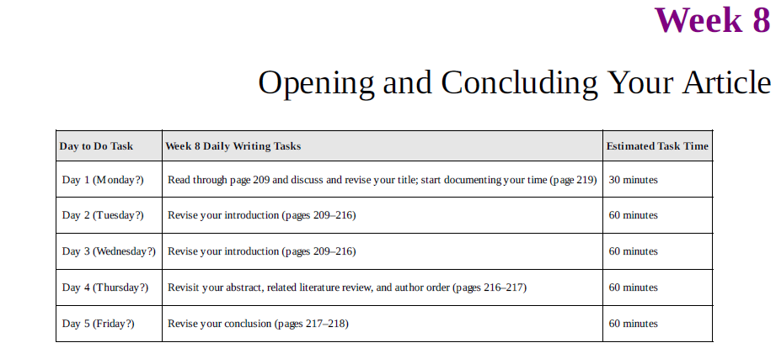
Week 8: Opening and Concluding Your Article

Slide 69
ON THE IMPORTANCE OF OPENINGS
First impressions are vital. (capture our consumer attention).
prove your paper value quickly.

Slide 70
The opening
For an article to get published, it must first do well in the peer-review process.
Peer reviewers can find an article frustrating if it fails to give certain information up front or twist for several pages before getting to the point.
In contrast, if your project, argument, approach, sources, contribution, and relevance are clearly stated in the first two or three pages, your article will tend to do better in peer review.
Starting strong will aid your article in making it through peer review regardless of field.
Any article you publish is competing for scholars’ attention with the multitude of other academic articles published in each field every year. With at least 200,000 academic articles and 12,000 academic books published every year in the United States alone (Bowker 2004)
Skimming (fast scan reading) has become a way of life. Scholars read fast the first page only if the value of the article has made itself apparent.
Only two moves establish an article’s value quickly: the reputation of the author(s) or the opening.
Articles with strong titles, solid abstracts, and compelling introductions are more likely to be accepted for publication, more likely to be read, and more likely to be cited.
المقالة التي تمتاز بالعناوين الجذابة والملخصات القوية والمقدمات الكفوءة ، من المرجح أن تتم قراءتها ، ومن المرجح الاستشهاد بها

Slide 71
Day 1: Revising Your Title
Avoid broad titles that would serve better for entire books or series.
Avoid strings of vague terms.
Name your subjects (Person, City, Country, region, population).
Suggest your argument if possible.

Slide 72
Day 1: Revising Your Title
Embed your title with searchable keywords
Avoid overly dense titles
Include a verb if possible

Slide 73
Days 2 and 3: Revising Your Introduction
The main purpose of the introduction is to provide enough information for the reader to be able to understand your argument and its stakes.
Introductions have some standard features in common.
Alex Henry and Robert L. Roseberry (1997) analysed the introductions and conclusions of articles and found that most shared three “moves.”
All article introductions stated the central idea (what I am calling the argument in this workbook). often included stating a fact, a problem, or a solution.
Many also introduced the general topic and then narrowed the focus to the specific topic.
Statements of the topic often included an example, a general history, a prediction, or a quote.
Narrowing the focus often included statistics, dates, examples, background information, or rationales for the argument.

Slide 74
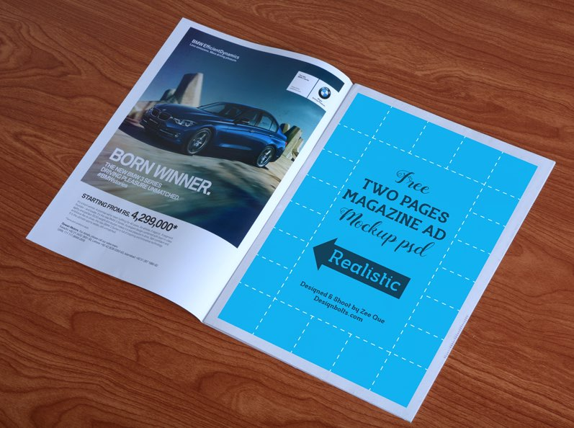
Day 4: Revisiting Your Abstract, Related Literature Review, and Author Order
If your title is the highway billboard ad, your abstract is the full-page magazine ad.
Many readers will decide whether to read your article based on your abstract. In fact, more than one person may cite your article on the basis of reading your abstract alone.
A good abstract is an extremely important part of getting into publication and disseminating your research.
Co-authors management : in which case you must make final decisions about whose name goes first on the article and whose second, and so on.
Some journals require authors to answer a series of questions about who conceived the hypothesis, who designed the experiment, who managed the laboratory, who collected the data, who analysed the data, who drafted the article, and who revised the article so that editors can accurately determine authorship.
Make a written agreement with the other authors before you even start drafting. Hammer out what constitutes the duties of a first author, second author, and so on.

Slide 75
Day 5: Revising Your Conclusion
A good conclusion is one that summarizes your argument and its significance in a powerful way.
The conclusion should restate the article’s relevance to the scholarly literature and debate.
It does not merely repeat the introduction, but takes a step back, out to the bigger picture and states why the argument matters in the larger scheme of things.
Two moves were generally present: the authors made a claim about the strength of the argument and its
supporting evidence and then linked that argument to the wider context (Henry & Roseberry 1997, 485).
That is, they stated how the internal outcome of the article (the success of the argument) can lead to an
external outcome (a change in the world or the way that we think about the world).
Social science conclusions also sometimes include remarks about possible directions for future research and reservations about the argument.
By the time you reach the conclusion, you may feel that you have no language left. If you are finding the conclusion difficult to write, ask your colleagues to read your article and tell you what they understand the article to be about and why it is important. They can often give you new language and slightly different ways of saying the same thing.

Slide 76
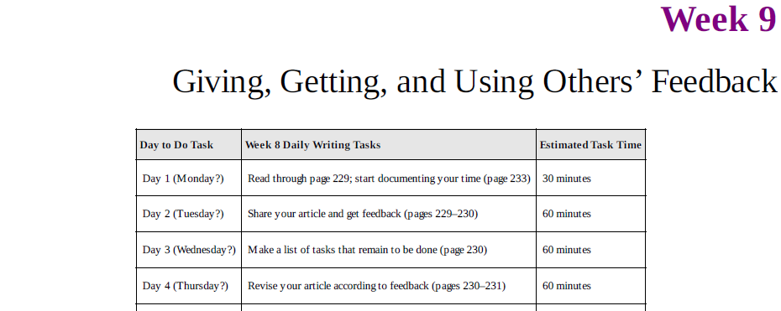
Week 9: Giving, Getting, and Using Others’ Feedback

Slide 77
Give Good Feedback
One of the best ways to improve your writing is to learn to give good feedback and be supportive of others’ struggles.

Slide 78
What Not To Do When You Are Giving Feedback
Do not obsess about the author’s bibliographic sources (don’t suggest lots of books, research to cite unless necessary) 30 pages article with 60 or less reference is considered good.
Do not obsess about what is not in the article (Don’t ask for additional research or experimentation; instead, comment on what the author managed to do with the data collected. If it isn’t convincing, then say it isn’t convincing.)
Do not obsess about fixing the article (focus on fixing others’ work, but on giving a response. It is not your job to fix other people’s articles; it is your job to give them your reading of it.)
Do not obsess about judging the work (If you can’t give feedback on an article at this initial stage without prejudice or emotion, best to leave it to others. If, however, you really disagree with the author’s topic or approach and want to take it on, make a concerted effort to remember that you are not a judge and that it is your job to provide a response.)

Slide 79
What To Do When You Are Giving Feedback
Start with the positive (A little bit of sugar makes the medicine go down)
Be specific (Vague praise such as “Good paper!” is not enough) - don’t tell someone, “Your writing style needs a lot of work,” as this is vague and unhelpful. Say instead, “You might think about working on making your sentences more active and less passive.
Focus on giving a response (what you understood their article to say)
Always suggest (frame it as a suggestion) - little question mark can prevent the criticism from making such a large dent in the author’s ego.
Focus on the macro (You will become known as a good reviewer if you can stay focused on the big stuff. ) Argument ? Strucure ? Evidence, Findings ? Methods ? Better than grammars and punctuation
Spend the time (8-12 h)

Slide 80
What to Do When You Are Getting Feedback
Give instructions (Specify part to check like methods, results etc..).
Separate the delivery from the message (Many people are bad at giving criticism—they don’t start with the positive, they get angry, they get frustrated. Try to ignore the emotion with which comments or suggestions are delivered).
Listen, don’t talk.
Take advantage.
You are the final authority on your own writing.

Slide 81
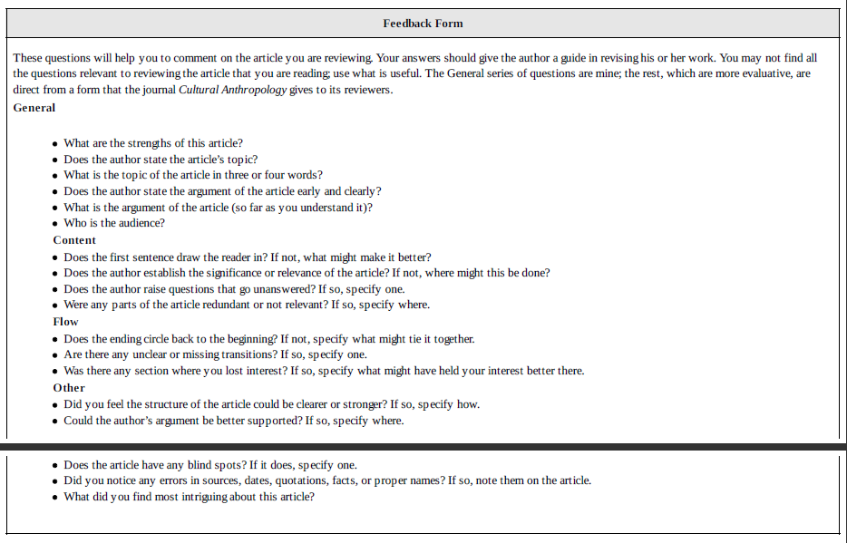

Slide 82
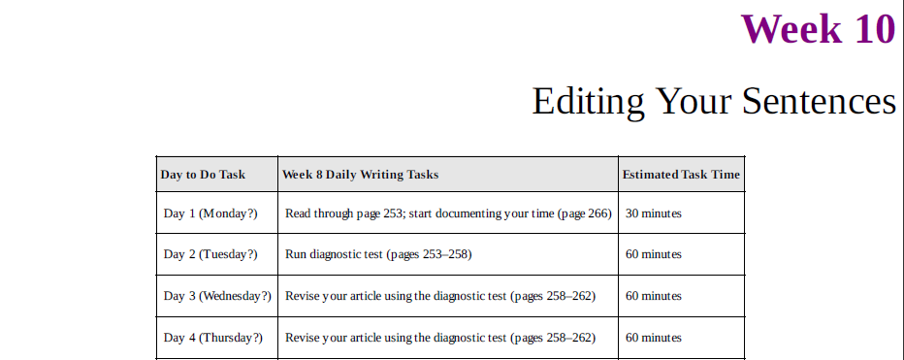
Week 10: Editing Your Sentences

Slide 83
ON TAKING THE TIME خذ وقتك
like an imposition to spend so much time writing something so small. But years later, that small thing would still be making a contribution, long after everything else I was doing, which seemed so important at the time, had been forgotten.”
Don’t let hectic life stop you from creating something permanent. You are getting close to the finish line, so keep moving!

Slide 84
TYPES OF REVISING
Macrostructure Revising (reviewing the literature, naming the debate, aiming for a particular journal, stating an argument early and clearly, and making sure you have a solid structure. Macrostructure revising involves big changes—moving paragraphs, adding examples, deleting sections, and rewriting pages.)
Microstructure Revising (Editing, proofreading)
Good writing can (unfortunately) cover up bad research and bad ideas, but good research usually cannot carry a badly written article into publication.

Slide 85
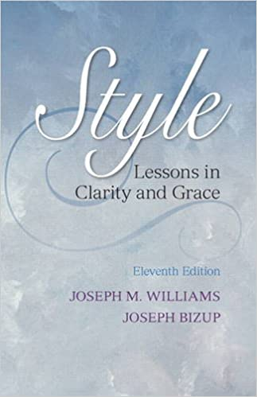
THE RULES OF EDITING
Look at every sentence in your writing
and ask yourself a simple question: Does the sentence have a character (noun subject) and does that
character act (verb)? Every sentence must tell a clear story, with both characters and actions. If the
character and its actions emerge in the first seven or eight words of the sentence (excepting introductory
clauses),

Slide 86
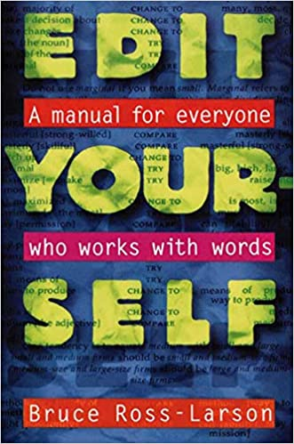
A manual for everyone
He doesn’t explain how to edit, he just provides hundreds of examples of poor word
phrases and their better versions. He arranges the examples in alphabetical order based on various style
manuals

Slide 87
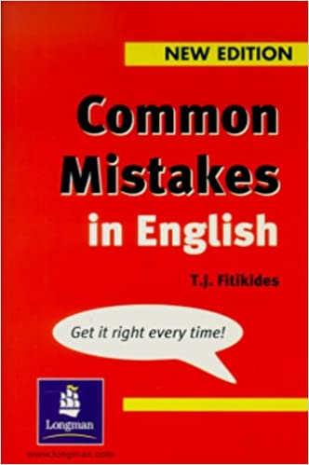

Slide 88
Principles of American English academic style
Don’t use two words when one will do.
Don’t use a noun when you can use a verb.
Don’t use an adjective or adverb unless you must.
Don’t use a pronoun when a noun would be clearer.
Don’t use a general word when you can use a specific one.
Don’t use the passive voice unless the subject is unknown or unimportant

Slide 89
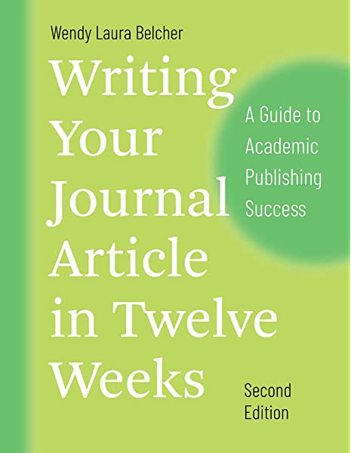
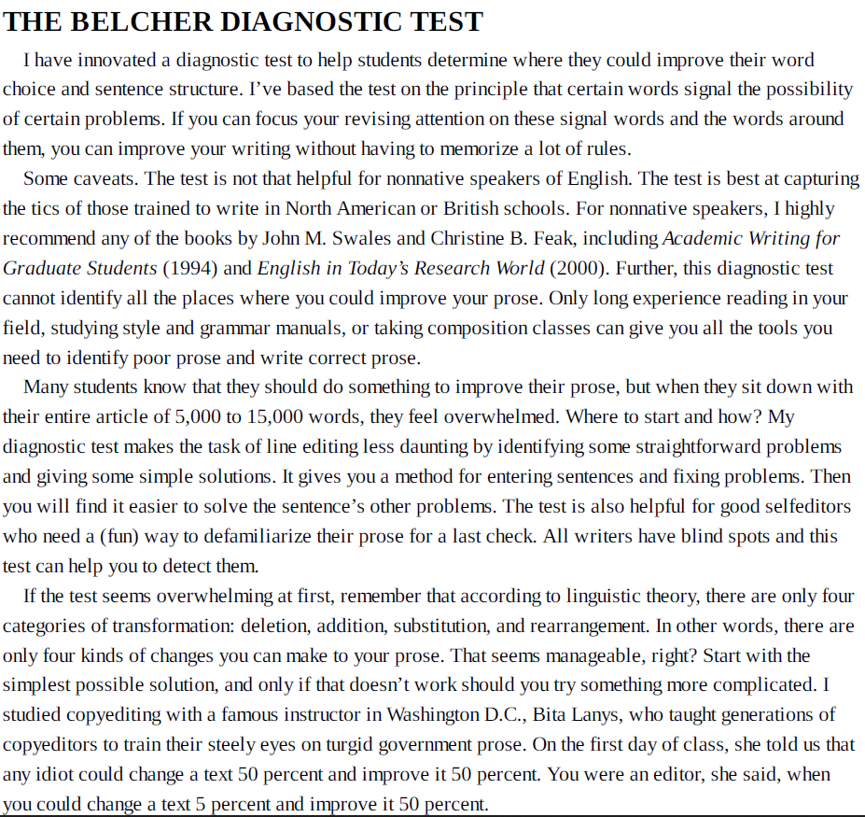
THE BELCHER DIAGNOSTIC TEST (p327)

Slide 90
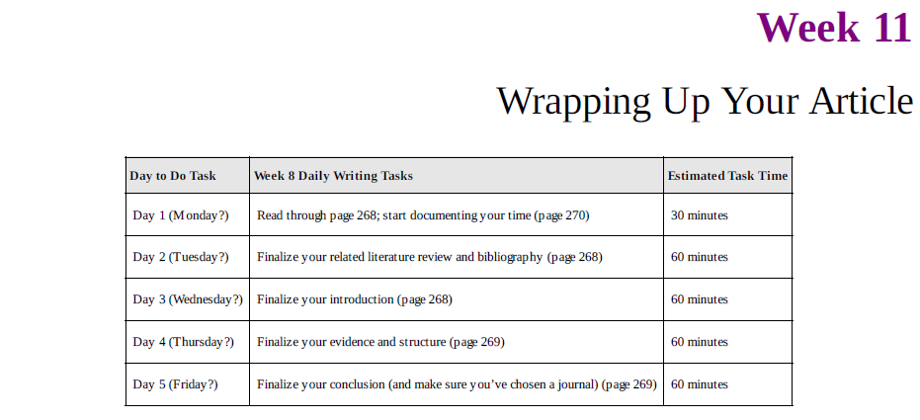
Week 11: Wrapping Up Your Article اختتام مقالك

Slide 91
Day 1: Finalizing Your Argument
Print out a hard copy of your article. Read through it and mark up what needs to be improved. Ask yourself if each change is essential to the article or a barrier to completing it.
Then review the instructions in Week 3 of the workbook, on argument, and reread the article with an eye for improving the logical flow of your article’s argument.

Slide 92
Day 2: Finalizing Your Related Literature Review
Review the instructions in Week 5 on related literature reviews, and reread your article with an eye for wrapping up your literature review and other citations.
Is your bibliography clean? Have you cited what you need to?

Slide 93
Day 3: Finalizing Your Introduction
Review the instructions in Week 8 on openings, and reread your article with an eye for completing your introduction.

Slide 94
Day 4: Finalizing Your Evidence and Structure
Review the instructions in Week 6 and 7, and reread your article with an eye for finalizing the body of your article. Focus on improving.
Don’t forget your journal’s word limits, but if you are only one hundred words over the maximum, don’t panic. Most editors don’t expect you to hit the mark exactly.
Devoting a three or four-hour stretch of time to this task may be helpful as you get close to sending.

Slide 95
Day 5: Finalizing Your Conclusion
Review the instructions in Week 8 on conclusions, and reread your article with an eye for completing your conclusion. The best conclusions are short, clear ones.

Slide 96
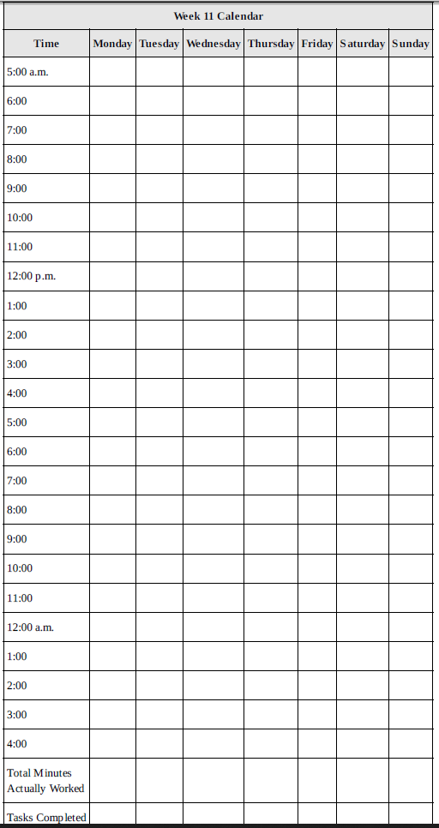
DOCUMENTING YOUR WRITING TIME AND TASKS

Slide 97
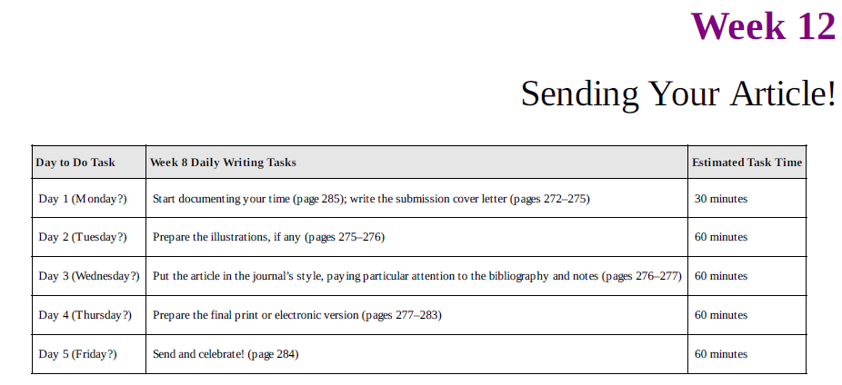
Week 12: Sending Your Article!

Slide 98
Day 1: Writing the Cover Letter
When submitting an article, authors often ignore the importance of crafting a good cover letter. A professional cover letter favourably disposes (set) the editor toward you and your work. While some journals do not examine them very closely, other journals use your cover letter to decide whether to read the article at all or to pick peer reviewers.
Use letterhead. If you are affiliated with a university, use university letterhead. (It gives a better impression than your personal stationery.)
Name the editor. Address the letter to a specific person, not just “Editor.” (Usually this information is online. It shows that you’ve done your research and are not randomly sending your work to any journal.)
Provide the title. Give the title of your article so that the editor has all the needed information in the letter.
Note if requested. If the article was requested in any way, thank the editor for requesting that you submit it and remind the editor of where this request was made.
Include the abstract. Describe the article’s contents. (It is fine to use part of your abstract to do this, but the abstract should be blended into the letter, not set apart as an abstract.)
Articulate the contribution. State the significance of work to the field. (This should be clear but not too self-aggrandizing. In other words, you don’t need to state that the article is going to change the field; just that it is a contribution to our thinking or fills a gap.)
Describe the appeal to the readers
Mention the journal
Offer warrants (Authorship, Ownership, Publication)

Slide 99
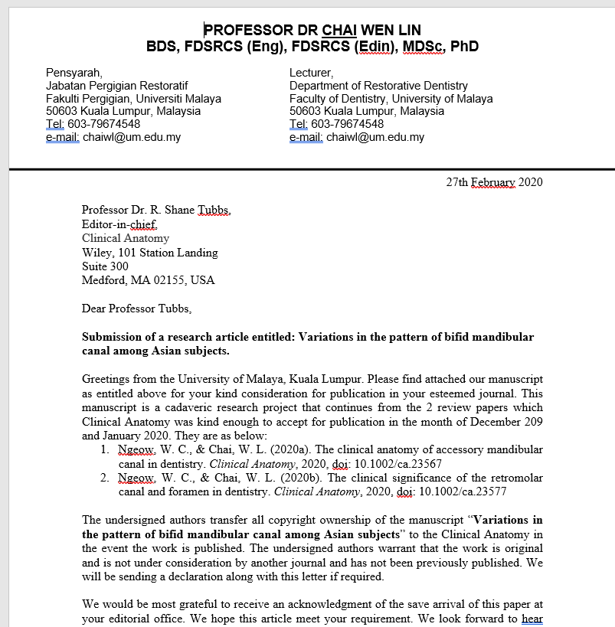

Slide 100
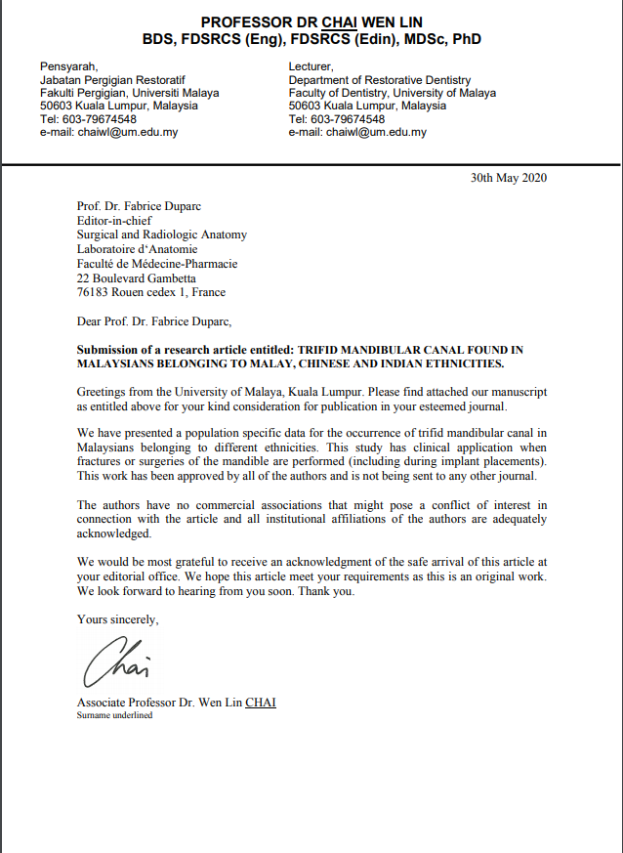

Slide 101
Cover Letter (Cont)
Submission. State that the article “is not currently under submission at any other journal or publisher.” (If your article is under submission elsewhere, you should not be sending it to a publisher.)
Give the word count. Provide the total word count of the article, including notes and works cited. (This is particularly important if you have worked to meet the journal’s word limit.)
Mention any permissions. State whether you are reproducing any copyright material in your article (e.g., maps, photographs, illustrations). If you are, state that you are currently requesting permission to reproduce copyrighted material.
Mention any funding. State any corporate funding sources for your project. (Editors will want to know if there are any possible conflicts of interest.)
Include your full contact information. Note any changes you anticipate over the next six months. (Be sure to include information for your co-authors as well, and to indicate who the “corresponding” author is, that is, the author who will be the point person.)

Slide 102
Cover Letter (Cont)
Omit status. Do not mention that you are a graduate student or an independent scholar. (Your status should be irrelevant to the editor. If the editor is unethical, then better to protect yourself by not including it.)
Miscellaneous. You rarely see any of the following statements in cover letters, but if they happen to be true of you, you might want to consider including them.
Human Subjects. In the social sciences, you may need to state that all human subjects gave informed consent and that your Human Subjects Review board approved your application.
Conflicts. In the social sciences, you may need to state that you have no conflict of interests, financial or otherwise, regarding the content or data in the article.
Awards. Note any awards you received for the article itself (e.g., best graduate student paper, best paper in conference) or to fund its research.
Buzz. Mention any attention that the article has drawn, such as sparking a heated debate at a recent conference.
Supplementary. Some authors mention the name of the good journals in which any articles directly related to the submission have been published. Others think this is tacky.
Coauthorship. Some social science journals will ask you to fill out a form on the contribution that each co-author made to the article. This will be made clear on the journal’s website, where they often provide a form.
Reviewers.

Slide 103
Day 2: Preparing Illustrations
If you plan to include photographs or illustrations in your article, you will need to provide the journal publisher with print-quality versions. You don’t need to include original illustrations in your initial submission; just a photocopy or scan of the illustration will do at this point.
A frequent mistake that beginning authors make is assuming that an image that works on the web or in a newspaper can be used in a print journal or book. It can’t. The amount of detail in a web image is thousands of times less than that needed for a print journal.
If you are scanning an original, be aware that the standard settings on most scanners will not be set high enough; a minimum of 300 dpi is usually required.
Poor scans from books or from photocopies will rarely be accepted for publication.
Plan in advance to procure good versions of your images since they may not be available for photographing when you want them. Archival items, in particular, are sometimes in process, moving, lost, or lent out, and so cannot be photographed.

Slide 104
Day 3: Putting Your Article in the Journal’s Style
Some editors require that initial submissions appear in their journal’s style, some don’t, but as one
journal editor said to me, “When an article arrives in our style, it looks like something we would publish.”
The easiest way to do this is to follow the instructions on the journal’s website or consult the style manual they use, of which there are four or five.
Style manuals give detailed instructions for the preparation of academic materials.
Each manual represents particular conventions of standardizing punctuation, spelling, foreign languages, capitalization, abbreviations, headings, quotations, numbers, names and terms, math, tables, figures, notes, and reference citations in text and references.
style manuals ensure that all the articles in a journal or book are presented in a uniform manner.

Slide 105
Day 4: Preparing the Final Print or Electronic Version
Always follow the journal’s instructions to the letter. In the absence of clear instruction, follow the instructions below. You can place a check in the box when you have accomplished each one.
Your name should appear nowhere in the article, including the citations.

Slide 106
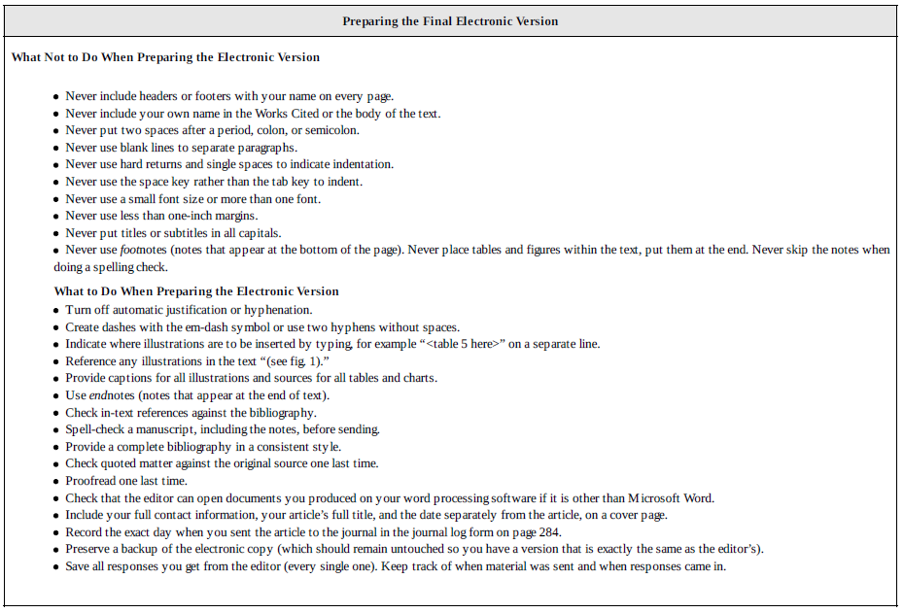

Slide 107
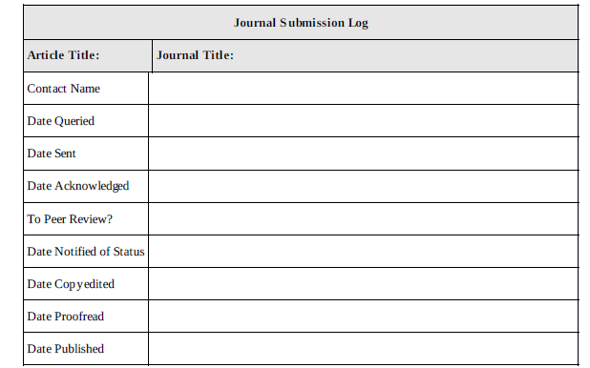

Slide 108
Day 5: Send and Celebrate!
Submit that electronic document online. Or, seal that envelope, walk it to the nearest post office, and drop it in the mailbox. Then go celebrate! You deserve it. You have just accomplished something many people dream of and never accomplish. You have joined those brave souls who have had the courage to send their writing to an actual publisher. Well done!

Slide 109
Week X: Responding to Journal Decisions

Slide 110
